Slide 1
Big Mountain Resort (BMR)
Kyle Stoudt - DSCT Guided Capstone Project

Slide 2
Problem Identification
The Goal:
The data has been analyzed, modelled, and utilized to determine a well-informed ticket price.
A model is provided that relates available facilities to ticket price that can be utilized as the available facilities at Big Mountain Resort change over time, and as costs must be cut to ensure a competitive position in the market.
The question: “How can Big Mountain Resort leverage available resort data to implement a more data-driven business strategy and set a better, industry-informed ticket price for the upcoming season and beyond?”
Initial investigation options:
Relationship of skiable terrain/no. of runs to adult ticket prices(weekend and weekday)
Comparison of ticket price to average snowfall and summit elevation to compare across similar geographies.
Ticket price to facilities(trams, chair lift count and types, no. of terrain parks)
Potential Constraints:
Any factors that affect ticket price (e.g. unforeseen fees, ticket printing, card-processing services.) that are universal to the industry will need to be addressed.
Data may need to be normalized according to projected days open as resorts may determine ticket price based on seasonal operating costs, annual visitors, and potential no. of days open.

Slide 3
Recommendation and key findings
Raise the current ticket price from $81.00 to ~$95.87 based on the findings of our model.
This change would more-than-cover the $1,540,000 additional operating costs incurred by the addition of the new chair lift.
Considering the proposed renovations, the scenario in which vertical drop is extended by 150 ft and a new lift is added will likely produce the best results for the investment.
We recommend closing no more than 5 runs, as the supported ticket price is predicted to decline significantly at that point.
More details for closures of 1-5 runs provided

Slide 4
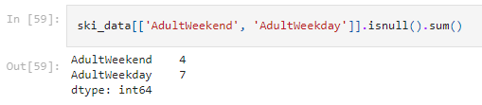
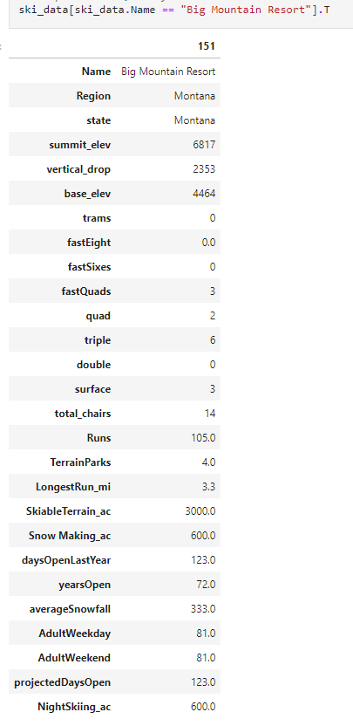
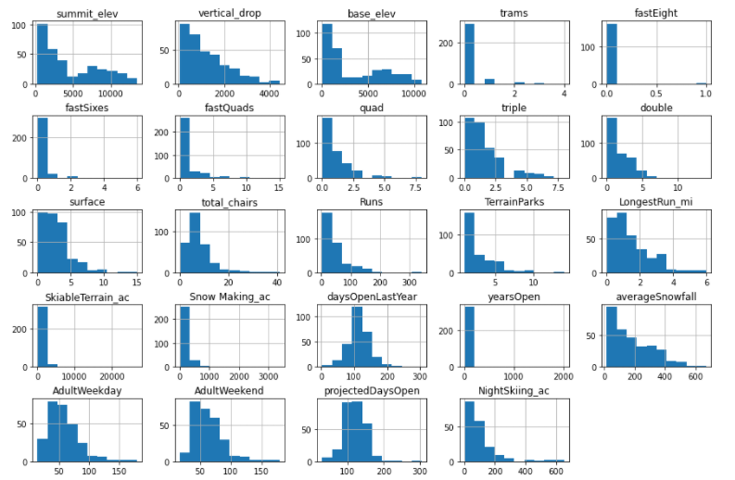
Modeling results and analysis
Data had to be cleaned: Missing values imputed or parent row removed.
‘AdultWeekend’ ticket price was decided to be the target variable, as it contained more values than ‘AdultWeekday’, which was removed from the dataset.
Data was appended to state_summary in the form of 'state_population' and 'state_area_sq_miles'.
This information is useful to have on-hand in future analyses, in case a consideration of state-wide population and square mileage is deemed relevant.
Initial look at the data by features:

Slide 5
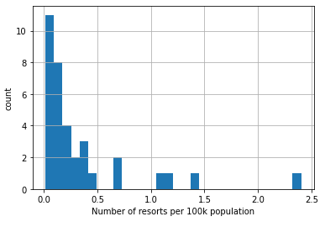
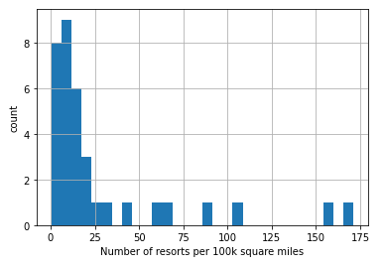
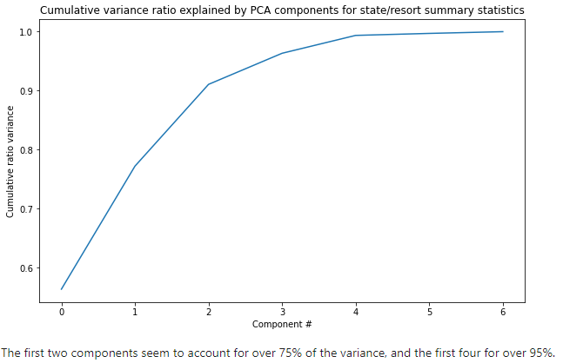
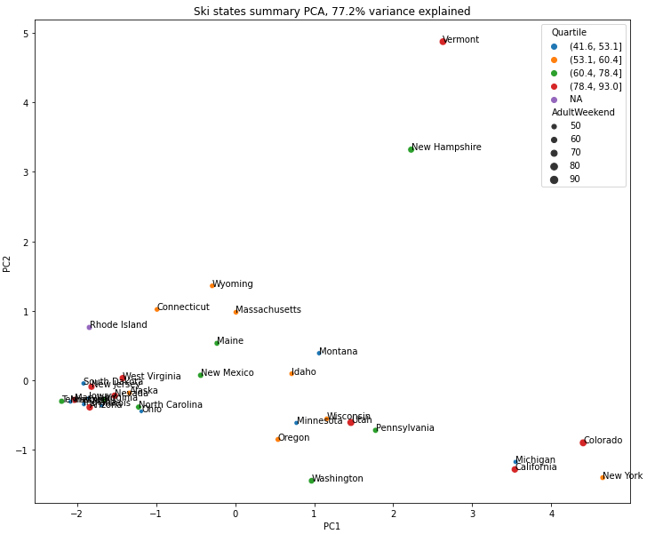
Modeling results and analysis
Metrics reflecting resort density were calculated and appended.
The data was scaled and a PCA transformation was fit to the data.
PCA transform was applied to create derived features to look for patterns in data and explore coefficients.
No clear grouping seen in state-based analysis.

Slide 6
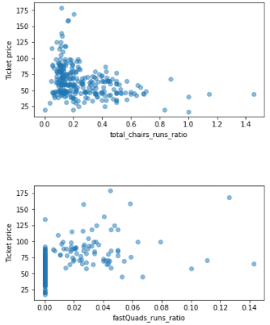
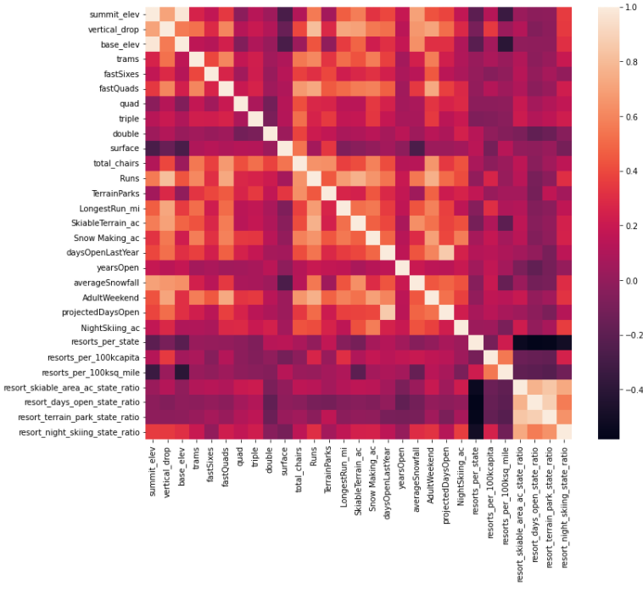
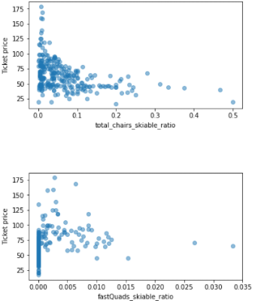
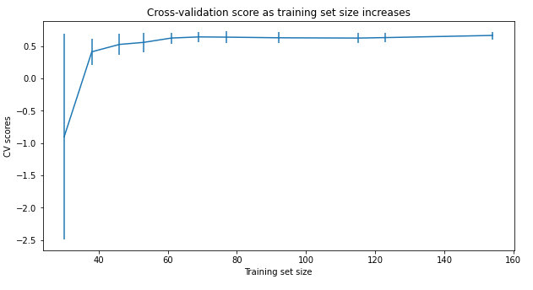
Modeling results and analysis
Produced correlations heatmap
Strong positive correlation seen with ‘vertical_drop’, ‘fastQuads’, ‘Runs’, and ‘total_chairs’.
In order to investigate how the ability to move riders around the resort affects ticket price, the following ratio features were added: total_chairs_runs_ratio, total_chairs_skiable_ratio, fastQuads_runs_ratio, and fastQuads_skiable_ratio.
Selection of a Random Forest model: Trained and tested a Linear Regression model on 70/30 train-test split for comparison.
Performance test by cross-validation shows the Random Forest model with a MAE of ~9.54 vs. Linear Regression at ~11.79.
A quick data quantity assessment shows we have enough data:

Slide 7
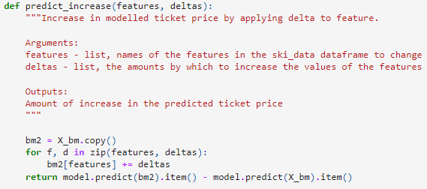
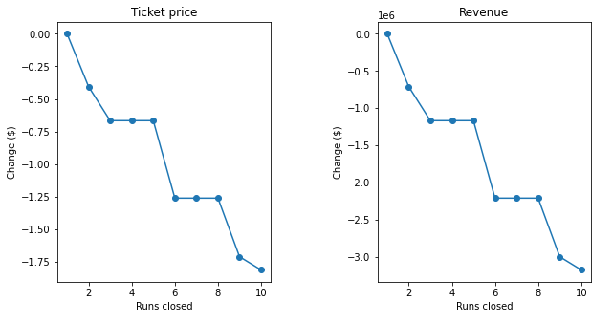
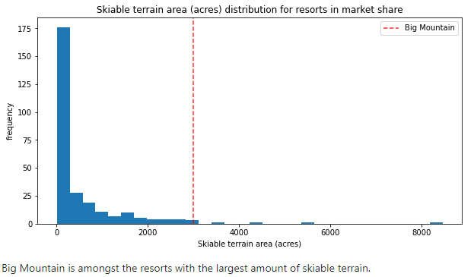
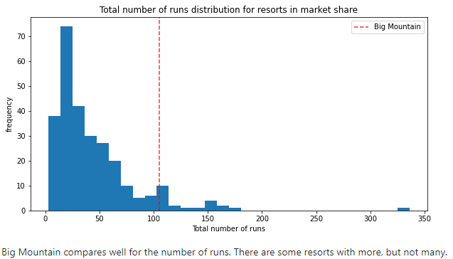
Modeling results and analysis
Refit model on all available data excluding BMR.
MAE: 10.39
STD: 1.47
Calculated expected BMR ticket price from the model.
Visually evaluated BMR’s position in the market by numerous components.
Evaluated 4 modeled scenarios to forecast supported ticket price increases.

Slide 8
Summary and Conclusion
We trained a Random Forest Regression model on a dataset containing information for ~330 US-based resorts in BMR’s market share. Using this model, we predict that BMR’s currently offered facilities support a ticket price of $95.87, whereas the current price is $81.00. Even with the model’s expected mean absolute error (MAE) of $10.39, there seems to be room for a price increase.
With ~1,750,000 expected ticket sales this season, this would provide an approximate $26,022,500 increase in revenue this year. This increase would certainly cover the additional $1,540,000 of operating costs incurred by the addition of the new chair lift. Prior to all this modelling, though, we checked to see how well the mean would perform as a predictor, and saw an MAE of ~$19.14.
This model can provide useful market analytics utilizing feature comparison across this population.
For example, we can see where BMR lies in the ‘Adult weekend ticket price’ landscape, both nationally and in Montana only.
In testing the proposed scenarios for BMR’s renovation, we predicted the most efficient option to be increasing vertical drop by 150 ft and adding another chair lift. This analysis showed an anticipated increase in supported ticket price by $8.61, which amounts to $15,065,471 over the season with our expected visitorship.
As for potential run closures, the model predicts no ticket price impact with the closure of 1 run, but predicts a lower supported ticket price successively when 2 or 3 runs are closed. However, if 3 runs are closed, the resort may as well close down 4 or 5 runs. As the closures increase to 6 or more, a large drop in ticket price, and therefore seasonal revenue, is predicted.
The model performs well but could be improved if we were able to acquire data covering operating costs for the resorts in this list. We could then hone in better on the strategy other resorts are using to optimize profits, and come up with a more-informed prediction for BMR’s ticket price.
Going forward, we recommend BMR consistently update this model with the most recent data available and use that to advise the ticket-pricing process. Further, business analysts may make use of this model, forecasting new supported ticket prices based on future changes.

